Slide 1
Keyword Research Using Keyword Planner
Team Members
1.Harish .C -8E0E4FDB6EDE135BC99463BF7F80F082
2. Jayapal .M -10BFD22FD91B9D5A6B649D2FCD4BB3F4
3. Deepak. R -9DFDF985C4FC711933E4B6077834F86E
4.Deepak .S-8BBEA82F38B820380CA46C34FD4FACB2
5.Bharath Srikanth. P- 1DB94440FC7FB40AE9E49813F967D58A

Slide 2
Project Details
Brand Name : LEOPSY
Category : Online Restaurant
Email :harishchinnakannu@gmail.com
BlogURL: https://harish7339090438.wixsite.com/leopsy

Slide 3
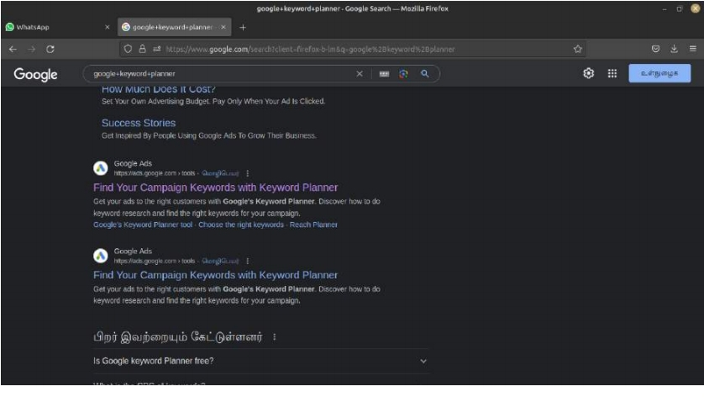

Slide 4
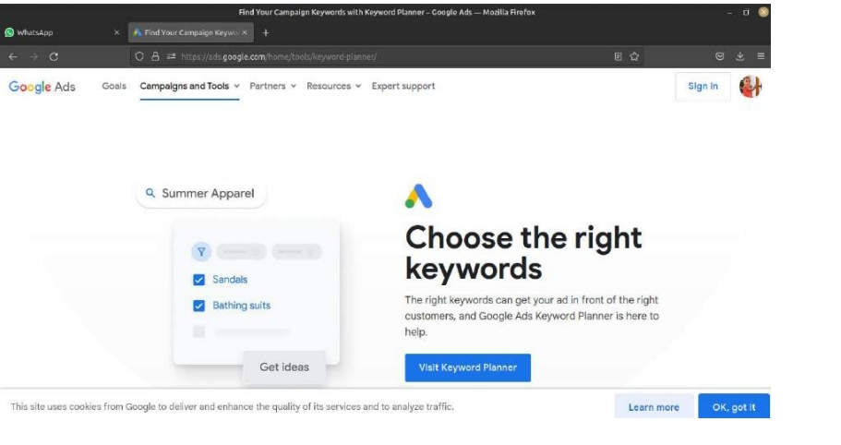

Slide 5
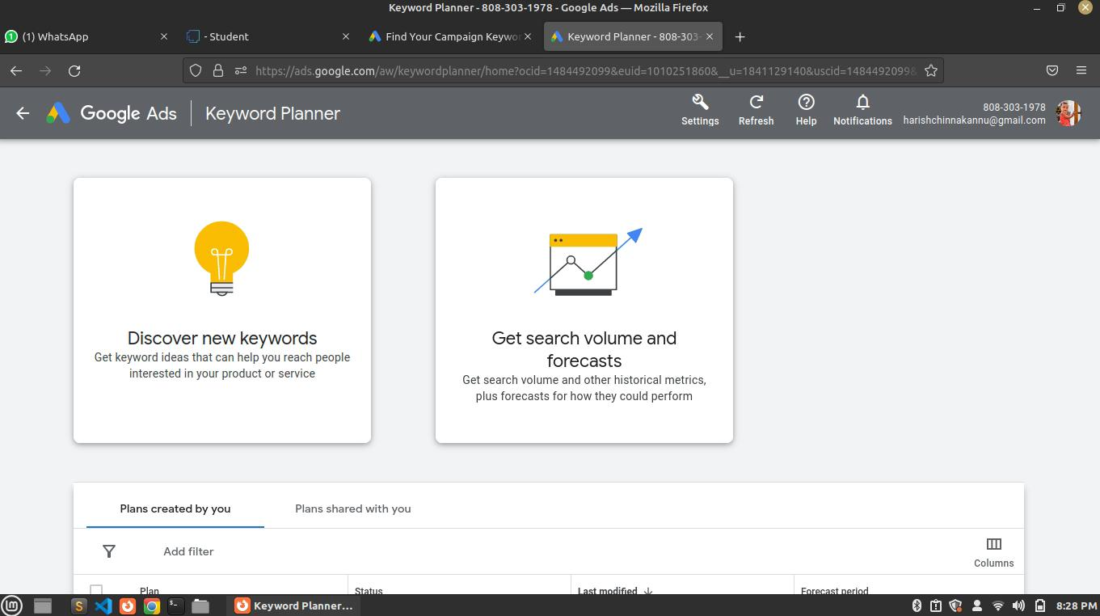

Slide 6
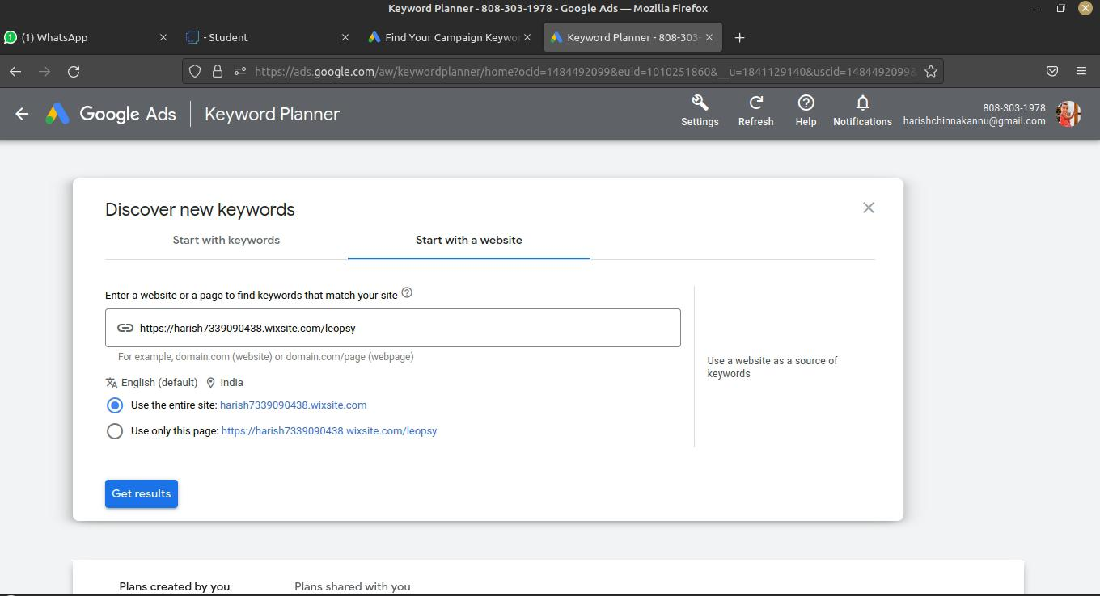

Slide 7
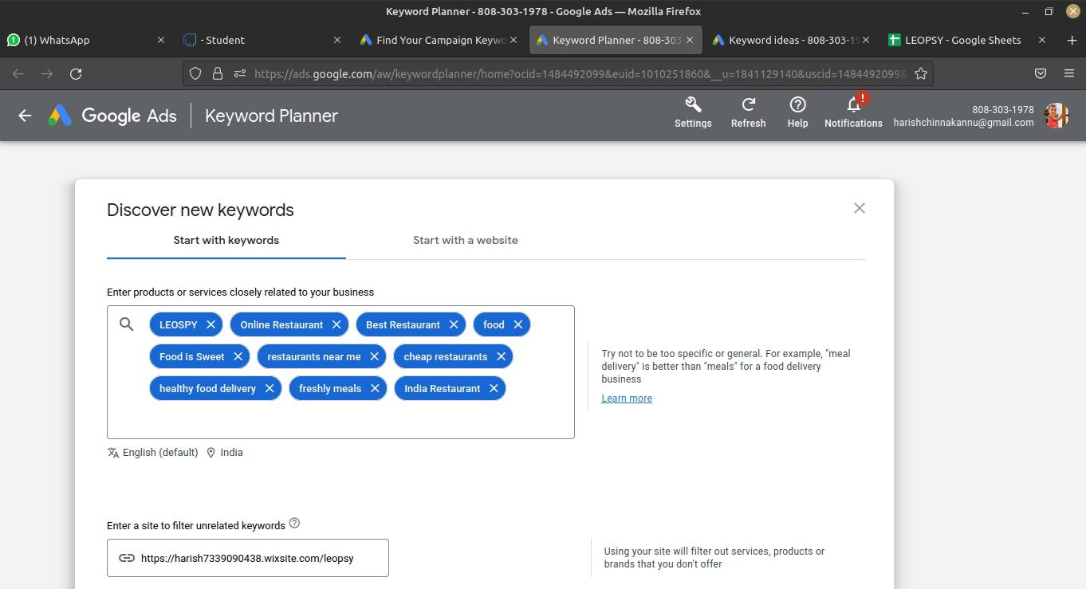

Slide 8
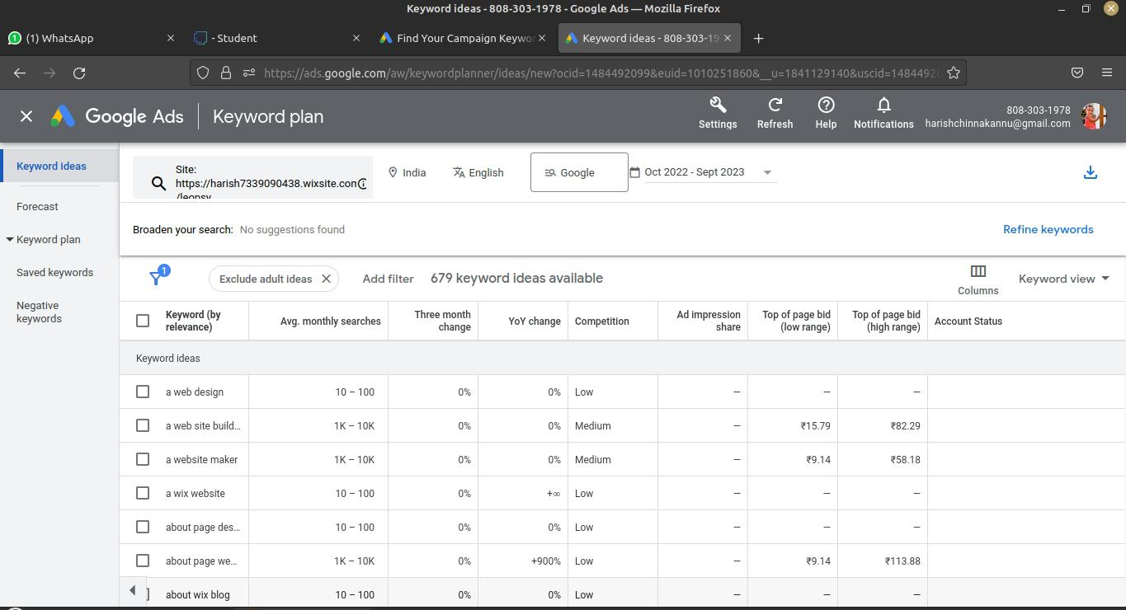

Slide 9
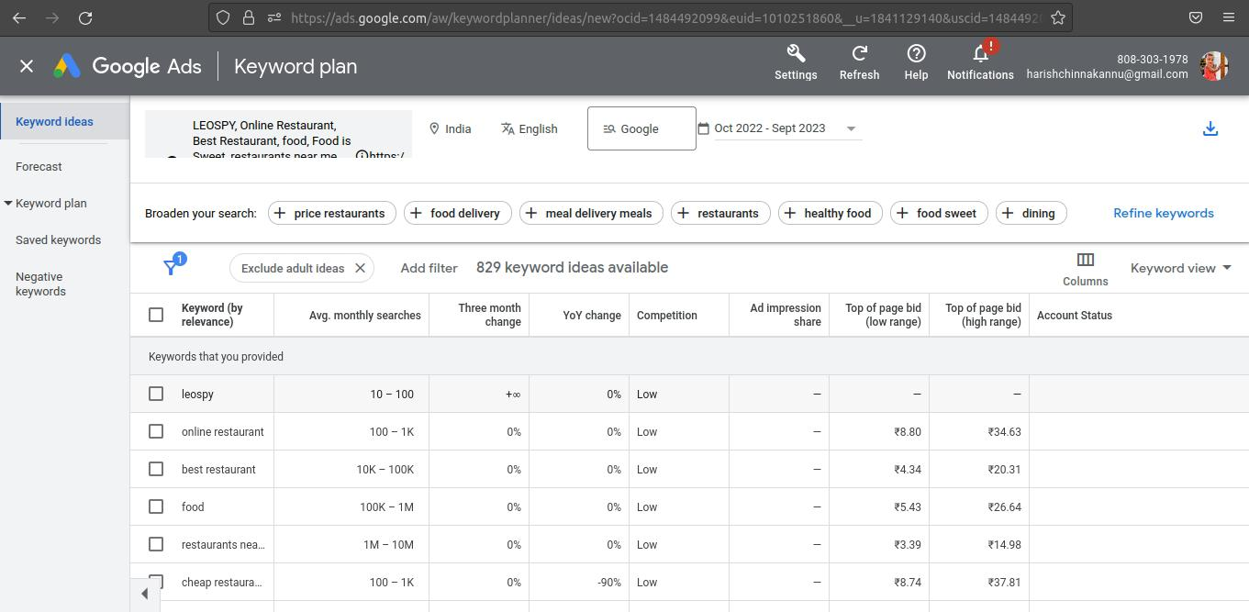

Slide 10
Project Links
Video link : https://drive.google.com/drive/folders/173JkzLptosGEda-5e9XdrG50E0TcmCu0
Facebook : https://www.facebook.com/LeopsyRestarunt?mibextid=ZbWKwL
Git up : https://github.com/Harish10042003/Nm-8E0E4FDB6EDE135BC99463BF7F80F082
Blog URL : https://www.blogger.com/blog/posts/8993326665400245507
Website : https://harish7339090438.wixsite.com/leopsy

Slide 11
Thank You

